Slide 1
Software Development Methodologies
Jerry Lebowitz

Slide 2
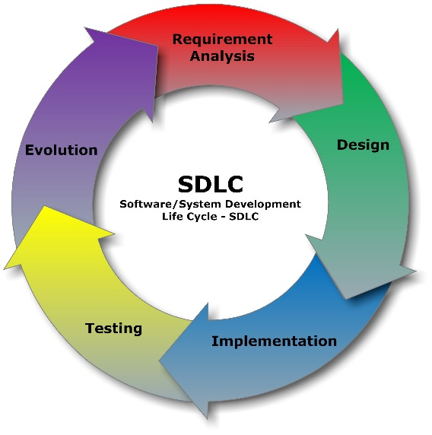
Software Development Methodologies

Slide 3
Topics
Software development life cycle (SDLC)
Waterfall
Spiral
Agile
Kanban
Scrumban

Slide 4
Software Development Life Cycle (SDLC)
A process is needed to develop software for complex systems
Waterfall
Spiral
Agile
Kanban
Scrumban

Slide 5
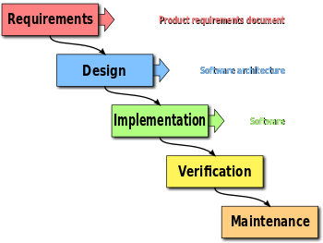

Waterfall

Slide 6

Waterfall Process (1)
Requirement
What the project is suppose to accomplish
Describe in a requirement document
Design
Plan for how to implement the system
What OO classes will be needed
Attributes and methods
Determine relationship between objects (inheritance)
Determine hardware/software/language/OS/etc
Implementation
Develop software/hardware

Slide 7

Waterfall Process (2)
Verification
Verify software against the requirement document
Unit and system
Maintenance/Deployment
Install and use the software for the intended use

Slide 8

Issues with Waterfall (2)
If a problem shows up in a later phase, the cause may be in an earlier phase
For example, an problem in testing may stem from a design issue
Customers do not see the final product until deployment
Wrong product could have been built

Slide 9
Waterfall Process Improved
To get customer involvement and feedback earlier in the software development cycle (SDLC), Barry Boehm (USC) developed the spiral model
Iterate the waterfall process
Early phases focus on the development of prototypes
A prototype is a small system that shows some aspects of the final system
Should be able to be developed quickly
Graphical user interfaces (GUIs), interfaces, etc.
The spiral process has a greater chance to delivering a system that meets the customers expectations

Slide 10
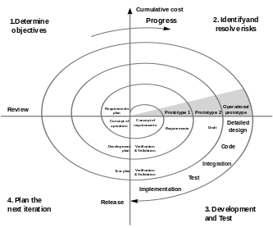
Spiral

Slide 11
Spiral Process Improved
To get consistent customer involvement and feedback throughout the entire in the software development cycle, the Agile development methodology was created
The premise behind agile is documented in the Agile Manifesto
See next slide and
http://agilemanifesto.org/

Slide 12

Agile Manifesto
We are uncovering better ways of developing software by doing it and helping others do it
Through this work we have come to value:
Individuals and interactions over processes and tools
Working software over comprehensive documentation
Customer collaboration over contract negotiation
Responding to change over following a plan
That is, while there is value in the items on the right, we value the items on the left more

Slide 13

Agile
Approach for developing software
On-going customer feedback
Strong team interaction as opposed to memos and e-mail
Used to deliver quality software products faster

Slide 14
Agile Frameworks
Extreme Programming (XP)
Crystal
RUP
Scrum

Slide 15

Extreme Programming
Extreme Programming (XP) is a software development methodology which is intended to improve software quality and responsiveness to changing customer requirements
Advocates frequent "releases" in short development cycles, which is intended to improve productivity and introduce checkpoints where new customer requirements can be adopted

Slide 16

Extreme Programming Paradigms(1)
Pair programming
Two developers working on the same computer
Two eyes are better than one
Small releases
Release software every two to four weeks
System metaphor
All programmers should understand the whole system
Refactoring
Continually clean up the code

Slide 17
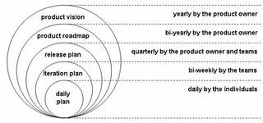
Extreme Programming Paradigms(2)
Continuous integration
Build the entire software baseline at least once a day
Coding standards
All programmers must following a well established standard
Collective code ownership
All programmers should be able to change any software

Slide 18
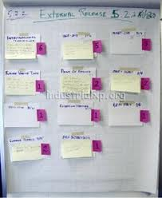
Extreme Programming Paradigms(3)
Simplicity
Design everything as simple as possible
Planning game
Iteration Planning: This plans the activities and tasks of the developers
Release Planning: This is focused on determining what requirements are included in which near-term releases, and when they should be delivered
Whole team
Everyone needs to be involved
Customers, users, developers, testers, etc.

Slide 19
Extreme Programming Paradigms(5)
Sustainable pace
programmers should not work more than 40 hour weeks
Test driven development
Each new feature begins with writing a test
This test must inevitably fail because it is written before the feature has been implemented
The next step is to write some code that causes the test to pass
Go back to step 1

Slide 20
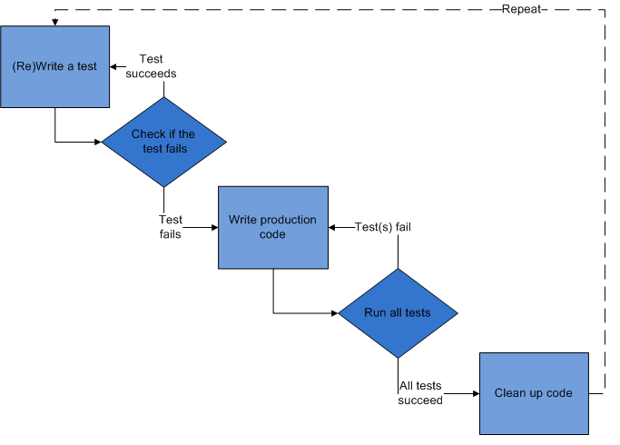
Test Driven Development

Slide 21
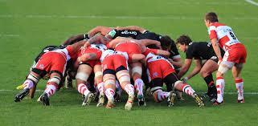
Scrum
Iterative, incremental framework
Encourages continuous improvement
Small pieces of functionality are developed and tested

Slide 22

Scrum vs. Waterfall (1)
Volatile requirements
Waterfall – may cause extensive rework
Scrum – should require reduced rework due to the iterative nature
Product
Waterfall – Customer views the finished product
Scrum – Customer constantly sees the product (more confidence)

Slide 23

Scrum vs. Waterfall (2)
Visibility
Waterfall – Little visibility
Scrum – Progress is constantly demonstrated
Verification
Waterfall – Begins after implementation (development) is complete
Scrum – Constantly testing using continuous integration

Slide 24
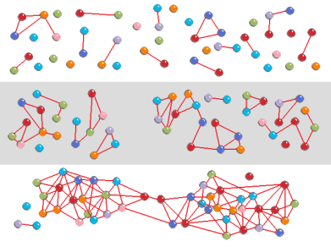
More on Scrum
Software development teams are self-directed, self-organizing, cross-functional
There is no overall team leader
Software teams continually learn as development proceeds
Software teams anticipate requirement changes
Software teams constantly verify software and adapt
Software teams are always able to deliver functionality

Slide 25
Team Roles
Product owner
Scrum master
Team member

Slide 26

Others
Managers
Interested parties (stakeholders)
Customers
CEO

Slide 27

Chicken and the Pig Scenario
A Pig and a Chicken are walking down the road.
The Chicken says: "Hey Pig, I was thinking we should open a restaurant!"
Pig replies: "Hm, maybe, what would we call it?"
The Chicken responds: "How about 'ham-n-eggs'?"
The Pig thinks for a moment and says: "No thanks. I'd be committed, but you'd only be involved."

Slide 28

Product Owner
Has the vision of what needs to be developed
Conveys that vision to the scrum team
Knows the customer’s priorities
Manages the backlog (features that need to be developed)
Determines when a feature has been implemented
Available to the team to answer questions
Single person

Slide 29

Scrum Master
Responsible for making sure a Scrum team lives by the values and practices of Scrum
Often considered a coach for the team
Helping the team do its best work
Facilitates continuous improvement
Process owner for the team
Protects the team by making sure they do not over-commit
Firewall for the team
Removes barriers
Anything that impedes the progress of the team

Slide 30

The Team
Three to nine individuals (cross functional )
Self organizing, self managed
Responsible for performing the work (writing the software, etc.)
Need to establish ground rules for the team
Team usually become more effective as time as progresses

Slide 31
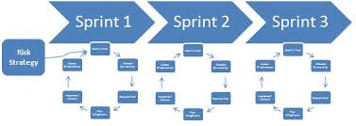
Scrum Definitions (1)
Sprint
The basic unit of development in Scrum
A sprint is a “timeboxed" effort; that is, it is restricted to a specific duration
The duration is fixed in advance for each sprint and is normally between one week and one month, although two weeks is typical

Slide 32

Scrum Definitions (2)
User story
One or more sentences in the everyday language of the end user that captures what needs to be developed
Use Case
Format: “As a <type of user>, I want <some goal> so that <some reason>
Contains a detailed description, story point estimation, list of assumptions, priority, assignee(s), list of tasks and tests, definition of done

Slide 33
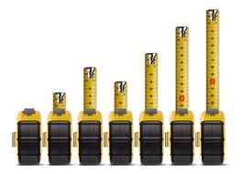
Scrum Definitions (3)
Backlog
Work to be done
Composed of stories
Story point
A story point is a relative measure used to determine (or estimate) the difficulty of implementing a given user story
Velocity
Story Points earned per sprint
Definition of Done
A clear and concise list of requirements that software must adhere to for the product owner to call it complete

Slide 34

Definition of Done
Code produced that adheres to a coding standard
Code commented
Code checked into source control system
Peer reviewed (or produced with pair programming)
Unit tests written and passed
Relevant documentation/diagrams produced and/or updated
Product owner concurs
What the customer sees to verify the story was implemented correctly

Slide 35
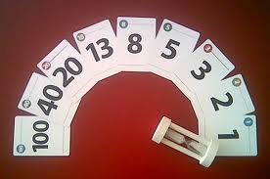
Planning Poker
Planning poker is a consensus-based technique for estimating effort
Mostly used to estimate effort or relative size of user stories
Uses a skewed Fibonacci series

Slide 36
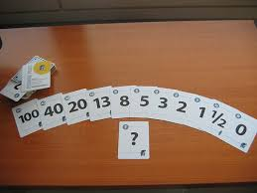
Planning Poker (2)
Members of the group make estimates by playing numbered cards face-down to the table, instead of speaking them aloud
The cards are revealed, and the estimates are then discussed
By hiding the figures in this way, the group can avoid the cognitive bias of anchoring where the first number spoken aloud sets a precedent for precedent for subsequent estimates

Slide 37
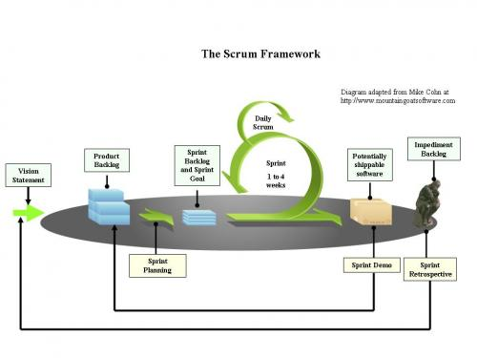
Scrum Process Summarized

Slide 38

Scrum Meetings
Meeting | Frequency | Participants | Output
Product Planning | Before the first Sprint | Product owner (PO) and stakeholders | Product backlog
Sprint Planning 1 | At the beginning of each Sprint | PO, Scrum Master and Team | Sprint backlog
Sprint Planning 2 | After Sprint Planning 1 | Scrum Master and Team | Sprint backlog decomposed into tasks
Daily standup (Scrum) | Daily | Scrum Master and Team | Updated status
Sprint demonstration | At the end of each Sprint | PO, Scrum Master and Tea | Completed or not completed stories
Sprint Retrospective | After the demonstration meeting | PO, Scrum Master and Team | Continually improvement

Slide 39
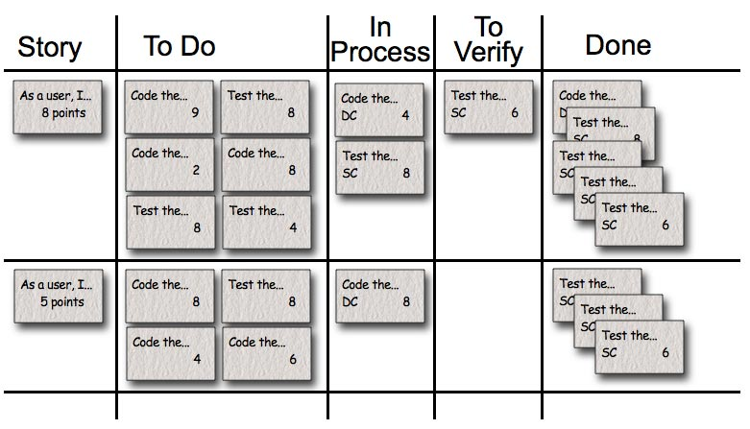
Keep Track of Progress
Use an agile management tool
Rational Team Concert (RTC), Jira, Scrumworks, VersionOne
Use an agile task board

Slide 40
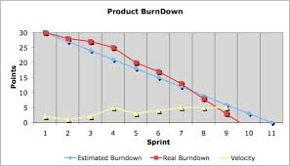
Product Burndown Chart

Slide 41
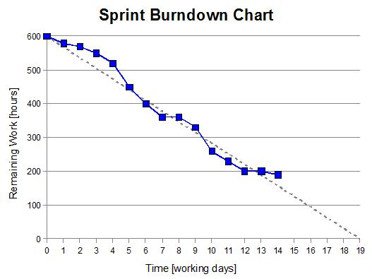
Sprint Burndown Chart

Slide 42
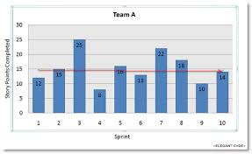
Velocity Metric Chart

Slide 43

Scrum at Large
Scrum teams are 3 – 9 individuals
If a project has 100 developers
Multiple teams are formed
Scrum of Scrums meetings are held

Slide 44
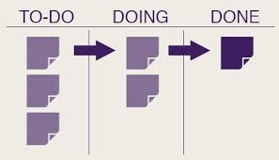
Kanban
Kanban was developed by Taiichi Ohno at Toyota, to find a system to improve and maintain a high level of production
Kanban is a method for managing work with an emphasis on just-in-time delivery while not overloading the team members
In this approach, the process, from definition of a task to its delivery to the customer, is displayed on a task board for developers to visualize
Developers pull work off a queue

Slide 45
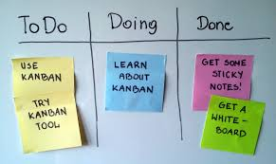
Key Elements of Kanban (1)
Just-in-time planning
Work in progress (WIP) limits
Explicit limits are established that specify the number of items that may be in progress at each workflow state
Managed by the number of item on a particular queue
Work is decomposed into user stories

Slide 46
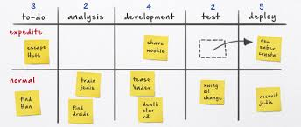
Key Elements of Kanban (2)
Uses a “pull” system to determine task assignment
(HP computers uses a push approach while Dell computers uses a pull approach)
Continuous improvement is promoted
No “time-box” concept
Used whenever Scrum is not applicable

Slide 47
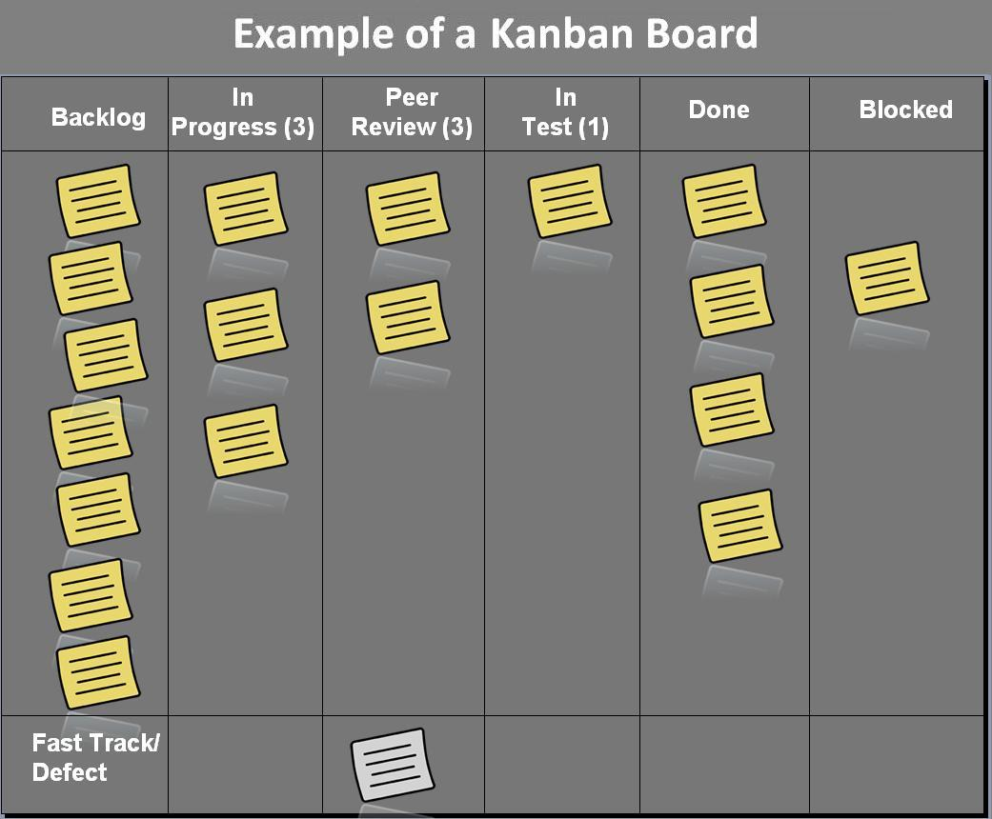
Kanban

Slide 48
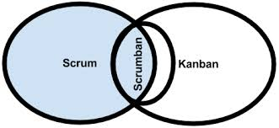
Scrumban
Uses features of Scrum and Kanban
Scrum features
Conducting daily stand-ups, demonstration, and retrospective meetings
Kanban features
Just-in-time planning and work-in-progress limits
Adds more structure to Kanban

Slide 49
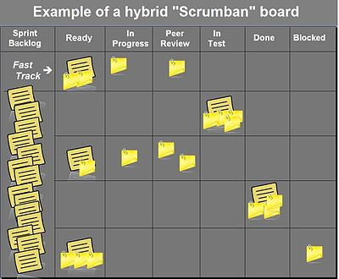
Scrumban

Slide 50
Lean Techniques (1)
Eliminate waste
Waste is anything that does not add value to a product
If a component is sitting on a shelf, that is waste
Amplify learning
Software development is a learning process
Decide as late as possible
Build a capacity for change
Deliver as fast as possible
Without speed, there is no reliable feedback

Slide 51
Lean Techniques (2)
Empower the team
Deliver increasingly refined versions of working software at regular intervals
Build in integrity
Software must maintain its usefulness over time
See the whole
Team performance suffers when individuals specialize and don’t see the entire picture
Tom and Mary Poppendieck

Slide 52
Quality Product Delivered on Schedule

Slide 53

Agile Quotes

